Slide 1
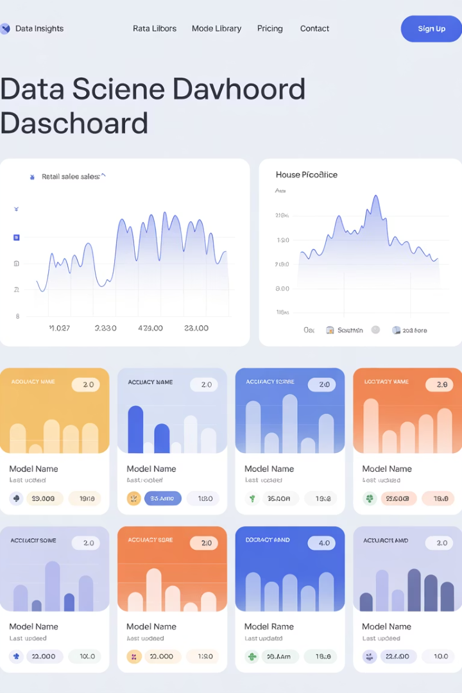

Forecasting Retail Sales and Predicting House Prices using ML
A dual-project exploration applying machine learning to time series forecasting for retail sales and advanced regression techniques for house price prediction.
by Jemael Nzihou

Slide 2





Presentation Overview
Store Sales Forecasting
Time series analysis using ETS and ARIMA models
Data Exploration
Stationarity checks and preprocessing steps
House Price Prediction
Advanced regression with feature engineering
Model Evaluation
Performance comparison and key insights

Slide 3
Project Introduction
Time Series Forecasting
House Price Regression
We'll explore sales prediction for grocery items using temporal data patterns.
Advanced techniques to predict residential property values from diverse features.
Models include ETS and ARIMA approaches for optimal forecasting.
We'll compare Ridge Regression and Random Forest models.

Slide 4




Store Sales Forecasting
Objective
Dataset
Approach
Forecast grocery sales for specific store-item pairs using time series models.
Seven files including sales, store, and product information plus economic factors.
Apply ETS and ARIMA models to capture temporal patterns in sales data.

Slide 5
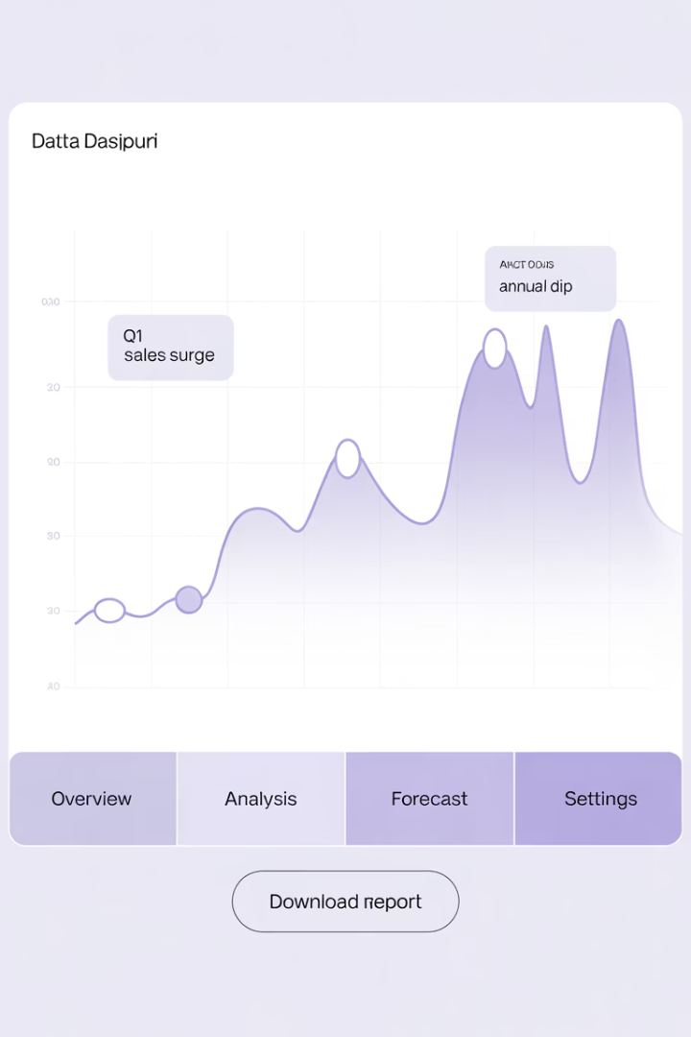
Data Exploration
Data Selection
Initial Visualization
Focused on Store 1, GROCERY I category for manageable analysis.
Data exhibits strong seasonality and potential trends.
Aggregated daily sales to identify temporal patterns.
Daily fluctuations show weekly shopping patterns.
Data Processing
Used pandas for time series manipulation and visualization.
Set regular daily frequency for consistent analysis.

Slide 6
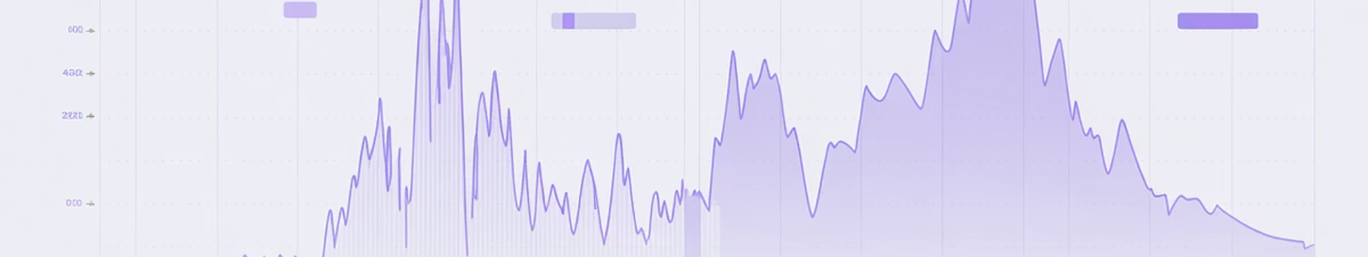
Stationarity Analysis
Verification
Differencing Application
Re-tested differenced series to confirm stationarity achievement.
Initial Assessment
Applied first-order differencing to remove trends.
Applied Augmented Dickey-Fuller test to check for stationarity.
Prepared data now suitable for ARIMA modeling.
Transformed data showed stable mean and variance properties.
Results confirmed non-stationarity in original sales data.

Slide 7
Time Series Modeling
ETS Model
ARIMA Model
Exponential smoothing captured trend and seasonal patterns.
Best model: ARIMA(5,1,0)(2,0,0)[7]
Fit time: 127 seconds
Implemented with seasonal period of 7 days.
Incorporated weekly seasonality with period=7.
Optimized parameters using maximum likelihood estimation.

Slide 8
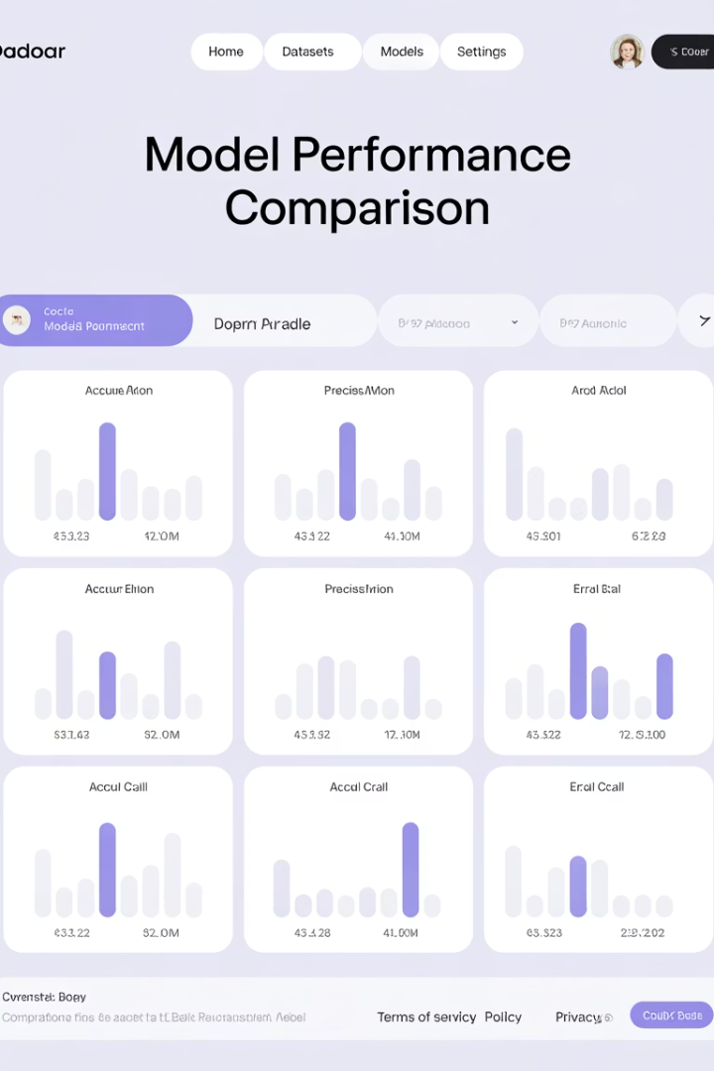
Model Evaluation
Model
MSE
MAE
ETS
235,334.39
294.18
ARIMA
322,677.16
374.67
ETS model outperformed ARIMA with lower error metrics across both measures.
Lower MSE indicates better overall prediction accuracy and fewer extreme errors.

Slide 9
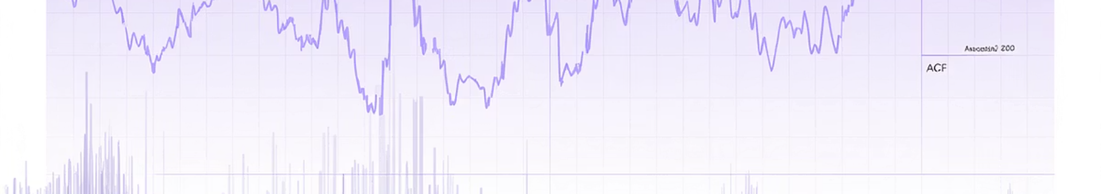



Time Series Insights
Residual Quality
ETS residuals approximated white noise with minimal autocorrelation.
Seasonality
Weekly patterns were effectively captured in both models.
Model Fit
No evidence of overfitting observed in diagnostic checks.

Slide 10






House Prices Prediction
Goal
Accurately predict house sale prices
Evaluation
Root Mean Squared Error on log-transformed prices
Techniques
Advanced regression with feature engineering

Slide 11
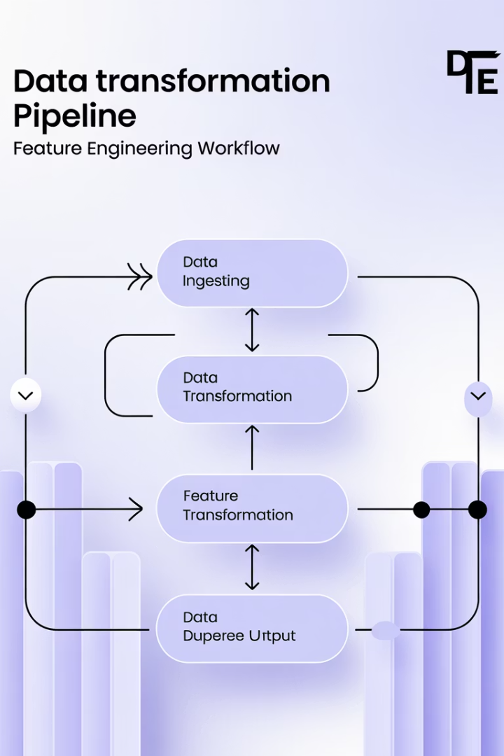




Data Preparation Pipeline
Dataset Combination
Merged training and testing sets for consistent preprocessing.
Missing Value Handling
Applied domain-specific strategies for different feature types.
Log Transformation
Applied to SalePrice to normalize distribution and stabilize variance.
Feature Engineering
One-hot encoding for categorical variables and polynomial interactions.

Slide 12
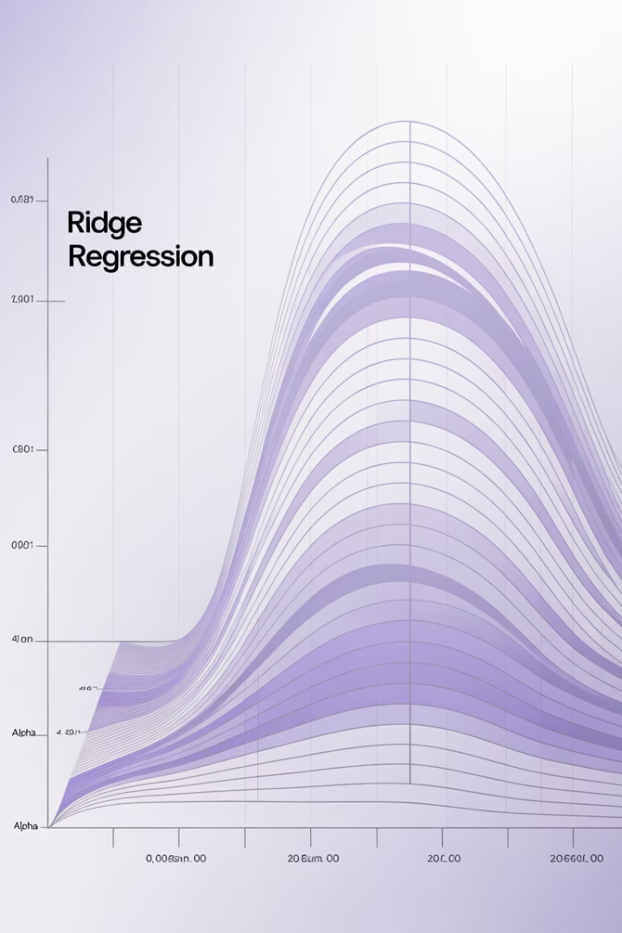
Ridge Regression
0.0123
0.00794
RMSE
MAE
Root Mean Squared Error
Mean Absolute Error
α
Regularization
L2 penalty mitigates multicollinearity

Slide 13








Random Forest Model
Multiple Decision Trees
Feature Randomness
Ensemble of trees trained on bootstrap samples
Random subset of features at each split
Non-linearity
Performance
Captured complex relationships in data
RMSE: 0.01149, MAE: 0.00766

Slide 14
Residual Analysis
Ridge Regression Residuals
Feature Importance
Normal distribution indicates unbiased predictions.
Top factors:
Homoscedasticity suggests consistent error variance across price ranges.
Overall Quality
Above Ground Living Area
No systematic patterns in error distribution.
Total Basement Square Feet
Neighborhood
Year Built

Slide 15



Dimension Reduction
PCA Application
Reduced feature dimensionality while preserving information
Variance Retention
95.15% of original variance explained
Model Interpretability
Simplified understanding of feature relationships

Slide 16
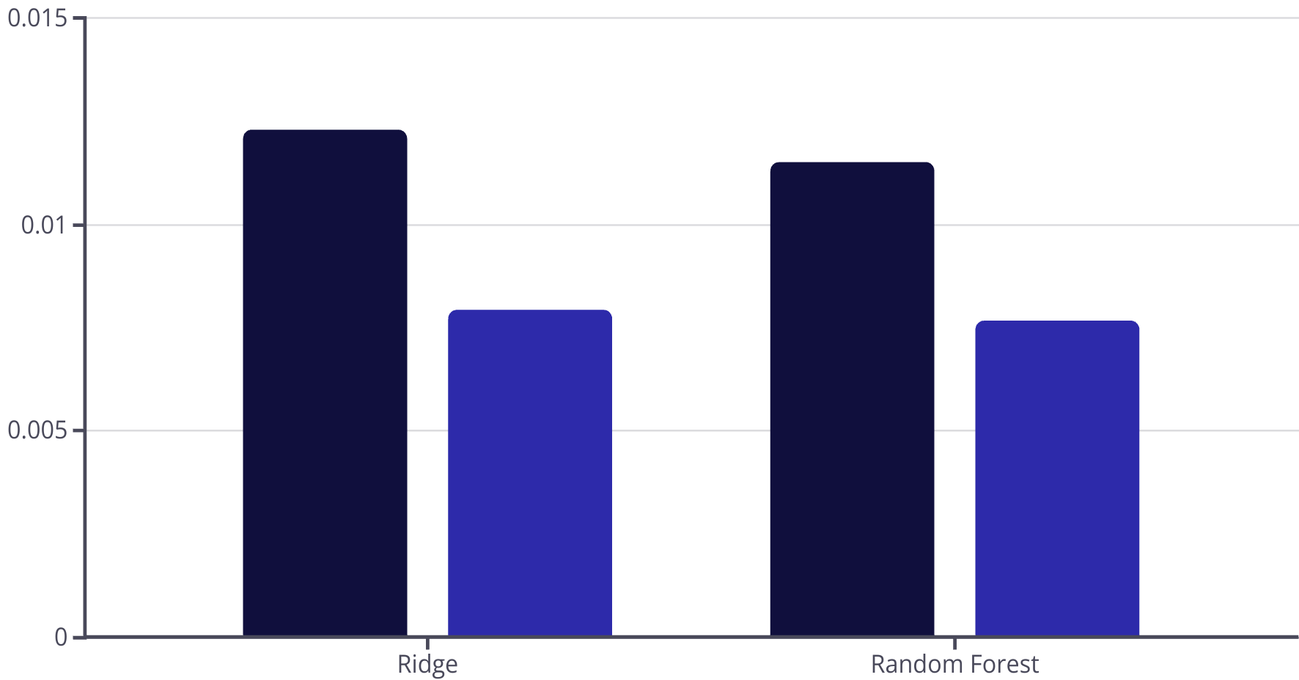
Model Comparison
RMSE
MAE
Both models performed well with different strengths. Ridge excels in simplicity. Random Forest captures complex patterns.

Slide 17
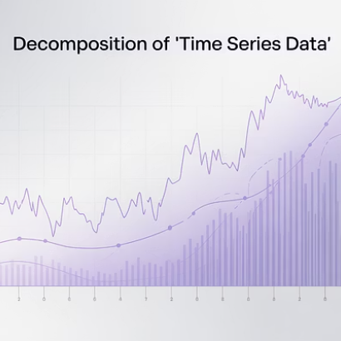

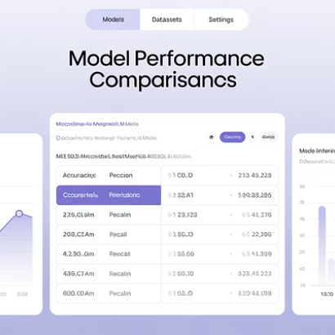
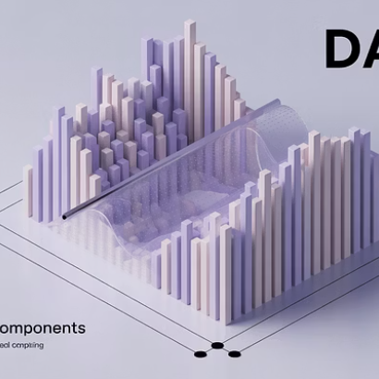
Project Insights

Slide 18





Key Learnings
Time Series
ETS outperformed ARIMA for this retail forecasting problem.
Regression
Ridge controlled multicollinearity while Random Forest captured non-linearity.
Preprocessing
Log-transformation stabilized variance and improved prediction accuracy.
Dimensionality
PCA maintained 95% information while reducing feature count.

Slide 19



Q&A Session
Time Series Questions
Regression Questions
Application Questions
Deeper discussion on ETS vs. ARIMA model components and assumptions.
Detailed explorations of feature engineering techniques and model selection.
Production deployment strategies and real-world implementation considerations.

